Slide 1
Dialog Models*
Presenter
Dr. Stephen Kimani
* Actually an intro. Students to explore more on their own.

Slide 2
Intro to dialog models
Dialog is a conversation between two or more parties.
In the design of user interfaces, the dialog refers to:
structure of the conversation/‘interaction’ between the user and the computer system
its primary focus is on the syntactic level of the 'conversation' between human/user and computer/system
description of order and structure of methods/services (i.e. inputs and outputs) used.
[cf: in human language, grammar of sentence construction.]

Slide 3
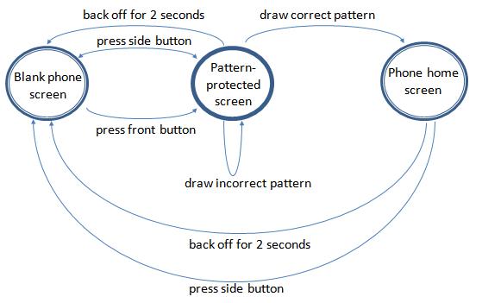

Example of a graphical dialog model
(Using State Transition Network)
User interaction with the mobile phone to access the phone’s home screen.
Some assumptions e.g.
not considering time-out after trying many times, “Sorry try again” message, “Emergency” option, etc

Slide 4
Why use dialog models
Dialog design notations are useful as follows:
supports automation of the generation and evaluation of interactive computing systems
separation of the user interface elements of the computer program from the actual semantics, and ease of analysis of computer program
ease of analysis of the proposed structure/design
provides a way for members of a design team to talk about the design

